Slide 1
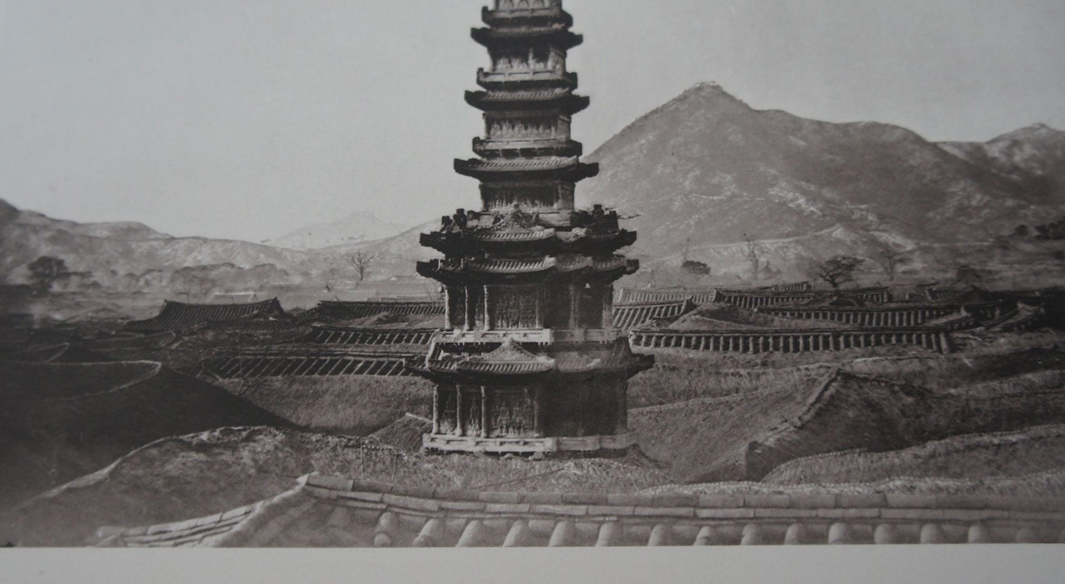
Figure 1
The Pagoda, Photographer, Percival Lowell, (c. 1883), Percival Lowell,
Chosŏn: The Land of the Morning Calm (1886), pp. 188.

